Slide 1

Cost And Cost Concepts
Name : Parmar Chaitali B.
Id Number : 217BEITG004
Sub : EEM.
Class : SY IT – 1.

Slide 2
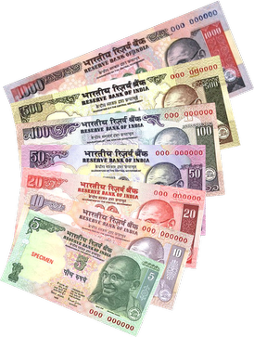
Contents
What is a cost?
Various cost concepts:
Variable and fixed cost
Total cost , Average cost And Marginal cost
Short-run and long run cost
Some other classification
Opportunity cost
Implicit cost
Sunk cost
Introduction to Break Even Analysis

Slide 3

What is a cost ?
Cost signifies the sacrifice of resources for generating some value from its consumption.
Example:-
If we want to buy a pen , we give money to
Shopkeeper so we give up our money to buy a
Pen.

Slide 4
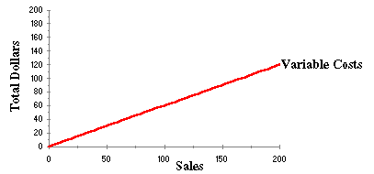
Cost Concepts: 1. Variable and fixed cost
Variable cost:-
The variable costs are those costs which vary with the volume of production.
Example:- Price of material

Slide 5
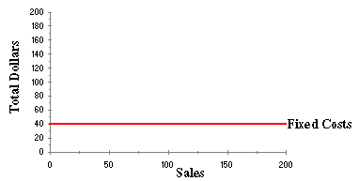
fixed cost:-
It remain fixed as per unit of time rather than volume of production.
Example:- Rent of the building.

Slide 6
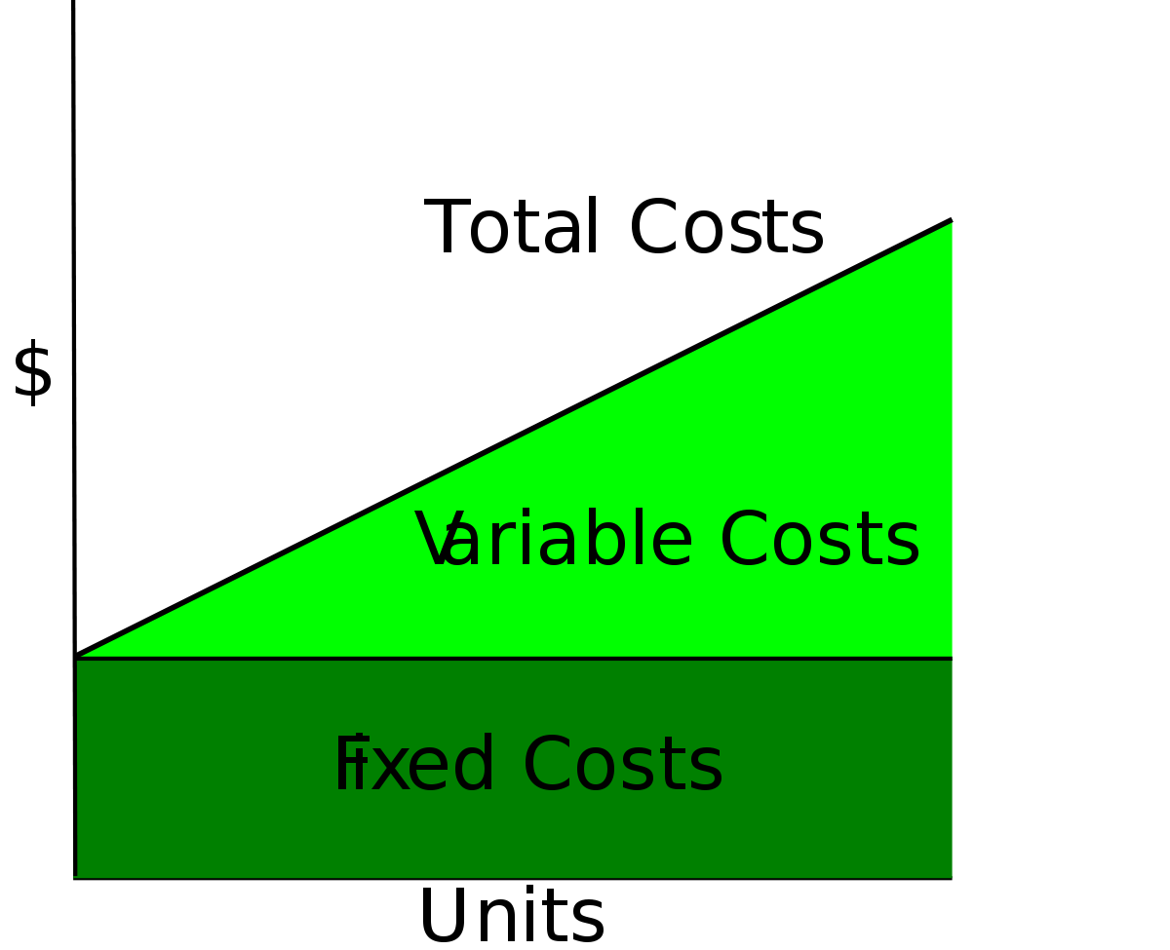
2.Total cost , Average cost And Marginal cost
Total cost:-
It is a sum of the total fixed cost and total variable cost.
TC=FC+VC

Slide 7
Average cost:-
The average cost indicates the per unit costs at different levels of production activities . It is ascertained as under :
Average cost per unit = (Total fixed costs + Total variable costs)
Number of units produced
AC= TC/N = FC/N + VC/N
Marginal cost:-
It is defined as the change in the total costs with one unit inceases or decreases in the current quantity produced.
MC= TC / N

Slide 8
3.Short-run and long run cost
Short-run cost :-
It has a short term service tenure, usually upto one year.
Example:- cost of labour
long run cost:-
The long term costs are those cost whose benefits tenure extend for several future years.
Example:- purchase a land , vehicle etc.

Slide 9
4.Some other classification
Opportunity cost:-
The opportunity cost is the cost of sacrifices of the next best alternatives.
Implicit costs:-
The implicit cost is to be understood with reference to the explicit cost . the explicit cost is certain and fixed cost like 10% interest on bonds indicates 10% explicit cost . But if the bounds are issued to day at Rs. 92 which are repayable after one year with its face value or Par value of Rs.100 ,then Rs.8 will become the implicit cost . The implicit interest cost is percentage will be 11.5%(i.e. Rs.92/Rs.8).
III. Sunk cost :-
Sunk cost are those costs which are unrecoverable once they are incurred.
Example:- Registration fee

Slide 10
Introduction to Break Even Analysis
It is a point of production resulting into no profit-no loss , it is also called a break even point.
And also a that type of analysis of any production level company called break even analysis.
Formula:-
Break even point ( In units ) = (Total fixed cost)/ contribution per unit.
Break even point (In Rs.) = (Total fixed cost)/ ((p/v ratio))
OR
Break even point (In Rs.) = (Total fixed cost)/ ((contribution /sales))

Slide 11
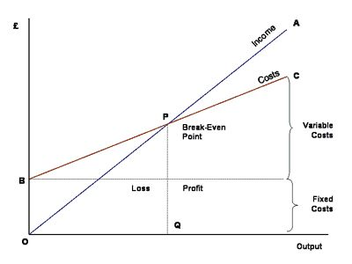

Slide 12
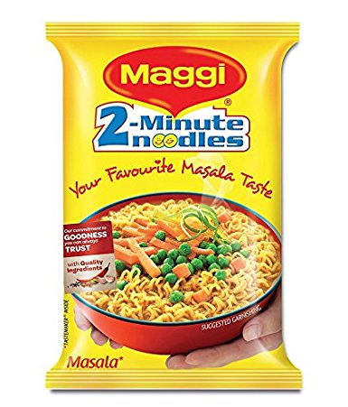
Case study:- history
The company originated in Switzerland in 1884, when Julius Maggi took over his father's mill.
In 1947, following several changes in ownership and corporate structure, Maggi's holding company merged with the Nestlé company to form Nestlé-Alimentana S.A., currently known in its francophone home base as Nestlé S.A.
Maggi instant noodles are popular in India, Pakistan and Malaysia. Nestle has 39% market share in Malaysia, where "Maggi" is synonymous with instant noodles, and had 90% market share in India prior to a nationwide ban

Slide 13
Fixed cost:
This is the cost which is independent of the quantity of the product produced e.g. Land &Building cost, plant & Machinery cost etc.
Land and Building
A plot of land of about 200 sq.mtrs. with built-up area of 100 sq.mtrs. is sufficient. Land would cost around Rs.60,000/- whereas cost of construction could be Rs.2.50 lacs. Main production area would occupy around 50 sq.mtrs. whereas packing room and storage area would occupy balance area.
Particulars | Area (sq. mtrs.) | Cost (Rs.)
Land | 200 | 60,000
Building | 100 | 2,50,000
 | Total | 3,10,000

Slide 14
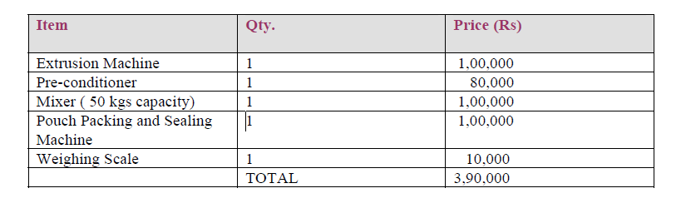
Plant and Machinery
Marketing is the key success determinant and the production capacity has to be finalized accordingly. Keeping in mind the financial viability, the rated production capacity is assumed to be 100 tonnes per year with 300 working days and 2 shifts per day.

Slide 15
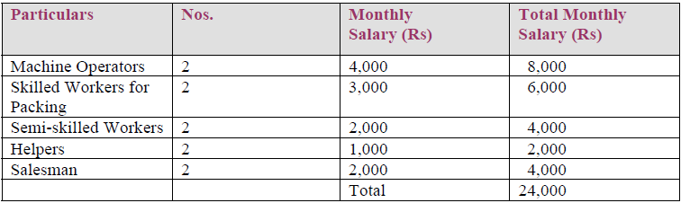
Variable Cost: this is the cost that varies with per unit of product produced e.g. Raw material cost, packaging cost etc.
A.MANPOWER REQUIREMENTS

Slide 16
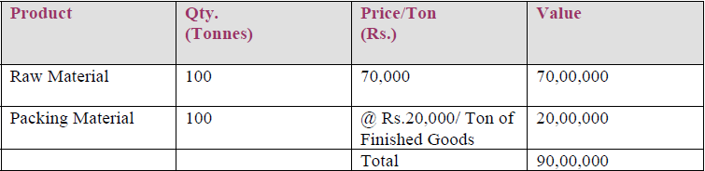
B. Raw and Packing Materials
Noodles are made with the help of many ingredients with major input being wheat flour. Other materials required are corn and rice flour, protein isolates, salt, spices, edible oil, preservatives etc. All of them are easily available. Packing materials are equally important. Colourful and attractive pouches shall have to be printed and outer packing will be corrugated boxes.

Slide 17
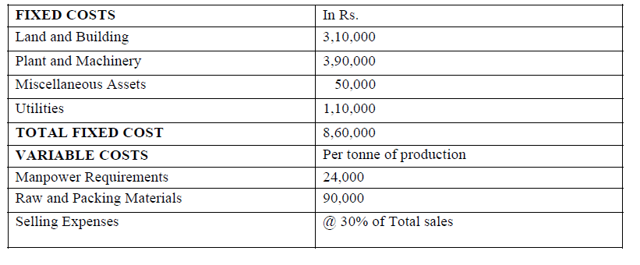
FINAL TOTAL COST ANALYSIS

Slide 18
ANALYTICAL BREAK-EVEN ANALYSIS
Let total production be X tones. Since the 80 gm pack of Maggi is available for Rs.20 i.e. Rs.250/kg so lets say that Maggi Noodle is supplied to the market agent at Rs. 180/kg
So for no profit no loss equation is
860000+ (1,14,000*X) + (30/100)*X*1000*180= (180*X*1000)
860000 = (180000-114000-54000)*X
X = 71.66 tonnes
Final conclusion: The plant must operate at the minimum efficiency of 71.66% in order to reach break-even analysis point i.e. not to suffer any loss.

Slide 19
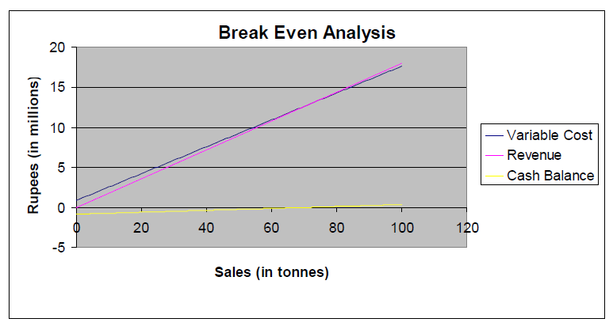
GRAPHICAL BREAK-EVEN ANALYSIS
The result obtained above can be verified by plotting a graph between the total cost and Quantity of Maggi produced. The graph is shown below.

Slide 20


